Slide 1
What makes a tweet viral? Observing patterns from the Canadian federal election

Slide 2

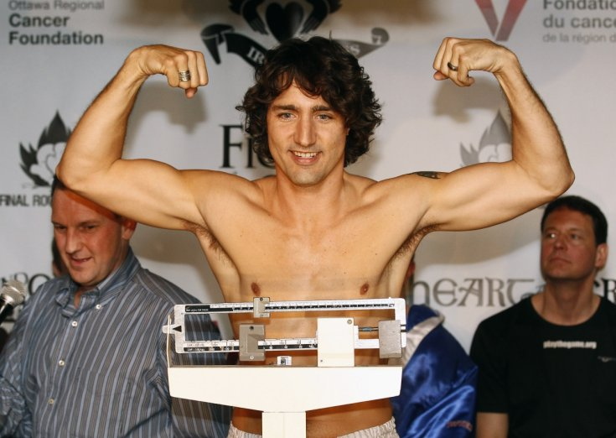

Slide 3
1.
Research questions

Slide 4
(i) Can twitter topic analysis be used in order to predict number of times a tweet will be ‘retweeted’?
(ii) Which topics were most heavily re-tweeted?
( iii) Which algorithms are most useful in classifying text data?
Notes:
Which tweets are most likely to be re-tweeted? Is this correlated with the topics that are most important to voters? Which algorithms are most useful in analyzing text data for predictive purposes? Such analysis is useful because it allows those invested in the political process to have a real-time gauge of public response to political positions announced by politicians on various issues.

Slide 5
2.
Dataset Description

Slide 6
The TwitteR package was used to search the API for 10,000 tweets containing the last name of each of the leaders of the political parties: Harper, Mulcair or Trudeau between the dates of Oct 1- 2015 to Oct 13- 2015.
Total of 30,000 tweets

Slide 7
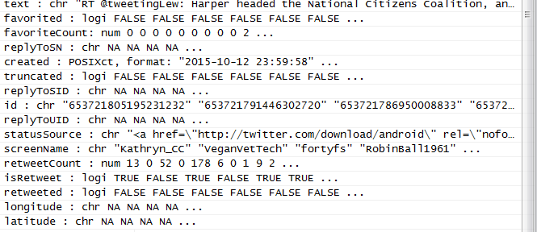

Slide 8
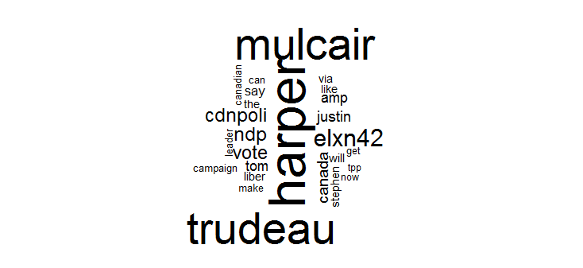
Word Cloud

Slide 9
Added Hour and Minute variables
Added 100 new variables using TFIDF
Data on follower and friend counts not available due to rate limits
Binning of re-tweet data

Slide 10
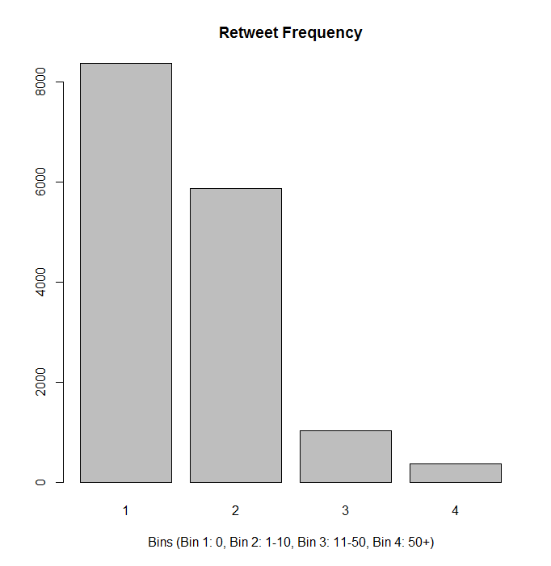
Transforming my problem into a classification problem
53%
Total 15648 tweets
38%
7%
2%
Notes:
Bin 1: All tweets with zero retweets
Bin 2: Tweets with retweetCount between 1-10
Bin 3: Tweets with retweetCount between 11-50
Bin 4: Tweets with retweetCount over 50+

Slide 11
3.
Methodology

Slide 12
8 steps
Data Collection
NLP processing of data (stopwords, stemming, sparse words)
Create topic clusters
Conduct Term Frequency Inverse Document Frequency
Create 3 different datasets
Prediction using Naïve Bayes
Prediction using Multinomial Regression
Evaluate results

Slide 13

Topic clustering using Knn

Slide 14
4.
Results

Slide 15
Accuracy
Data set | Description | Naïve Bayes | Multinomial Regression | Baseline
1 | 7 (no text) | 0.78 | 0.81 | 0.53
2 | 7+1 (cluster data) | 0.53 | 0.54 | 0.53
3 | 118 (TFIDF data) | 0.09 | 0.79 | 0.53
Notes:
Dataset 1: No variables representing tweet data. Bin prediction using only favorited, favCount,truncated, isRetweet, Retweeted,hour, min variables [total 7 predictor variables].
Dataset 2: Cluster variable is added to the dataset. Therefore, Bin prediction using favorited, favCount,truncated, isRetweet, Retweeted, hour, min and cluster variables [total 8 predictor variables].
Dataset 3: TFIDF variables added to the dataset. Cluster variable removed. Bin prediction using favorited, favCount, truncated, isRetweet, Retweeted, hour, min and 115 variables [total 123 predictor variables].

Slide 17
Conclusions
Multinomial regression outperforms naïve bayes regardless of dataset.
The most predictive model for retweets included the dataset with no text data and using the multinomial algorithm with 81% accuracy.
When text data was included multinomial regression analysis resulted in an accuracy of 79% while Naïve Bayes significantly underperformed at 9%.

Slide 18
5.
Lessons learned

Slide 19



Experiment design is tricky…
Your research question is limited by the dataset that you can compile. Originally I planned to do a sentiment analysis to predict electoral outcomes at the riding level, and compare to major poll results…

Slide 20
Extracting meaning from text data is a multi-step process
Knn clustering was not useful here
Next time a clustering after filtering party names and leader names could be attempted
TFIDF helped to maintain the nuance in the dataset
Next time PCA could be applied to this data frame to find the most meaningful word combinations
Notes:
In this study, clustering of twitter data using the knn algorithm was not useful. There was too much overlap in the four topics and the most common terms were those of the names of the politicians and political parties. This was reflect ed by the fact that the dataset that included text data had the lowest accuracy level of prediction in all trials. In the future, a clustering could be attempted after filtering for political names and parties. In order to get around this problem, it was useful to use the Term Frequency Inverse Document Frequency. This enabled me to retain the nuance of each tweet, and keeping over 100 variables rather than reducing each tweet to be summarized by just 1 variable (i.e. a cluster number). In the future, a PCA of the text words could be conducted in order to filter down the text data to the most meaningful words (thus reducing the data set from 100 text variables to a smaller number).

Slide 21
Which algorithm was best?
This study showed that as a predictive algorithm, the Multinomial Logistic regression was superior to the Naive Bayes algorithm regardless of dataset.
The reason why is to be explored.
Notes:
1% to 70% improvement in accuracy?

